Slide 1
Practical Course: 3D Scanning and Spatial Learning
Armen Avetisyan, Aljaž Božič, Justus Thies

Slide 2
Organization
Today: Project teams of 3 students
Bi-weekly status reports
10min talk + 5min discussion/questions
No need to hand-in slides before the talk
Alternating presenter
Final report, Final presentation
Last week of the semester
Talk: Semi-final slides should be sent one week before
Report: 3-4 pages in CVPR format

Slide 3
Projects
Real-time Scan2CAD (Armen)
Integrate the Scan2CAD network in Bundle-Fusion / VoxelHashing
Multi-view RGB-D Capture Setup (Aljaz)
Multi-camera setup, 3D Calibration, Volumetric Fusion
Morphable Model Generation (Justus)
RGB-D face dataset, non-rigid template fitting, PCA
Real-time RGB Face Reconstruction (Justus)
Cuda/DirectX face fitting (shape, albedo, light)

Slide 4
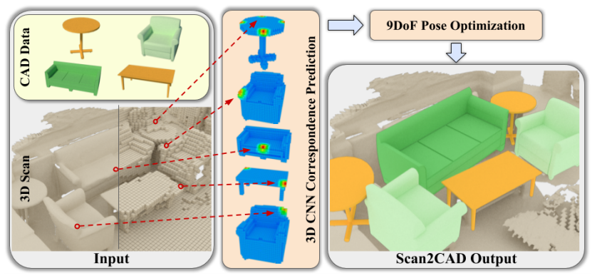
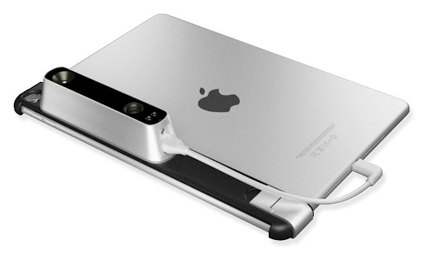
Real-time Scan2CAD

Slide 5
Real-time Scan2CAD
Step 1
3D scan whole room via Voxel Hashing (Niessner et al., 2013)
Step 2
Predict CAD alignments with CNN from SDF grid
Step 3
Visualize alignments interactively

Slide 6
Real-time Scan2CAD
Data:
Apple Ipad + StructureIO
Literature:
Avetisyan, Armen, Angela Dai, and Matthias Nießner. "End-to-End CAD Model Retrieval and 9DoF Alignment in 3D Scans.", ICCV 2019

Slide 7
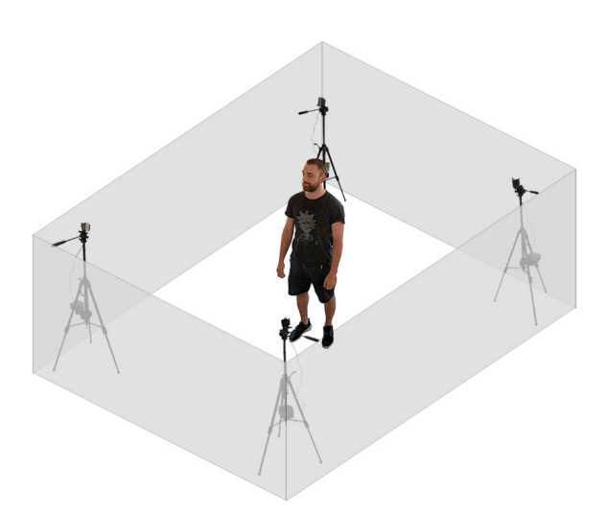
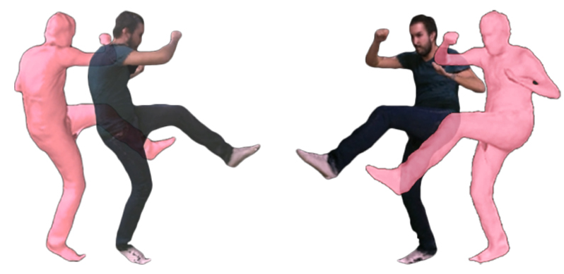
Multi-view RGB-D Capture Setup

Slide 8
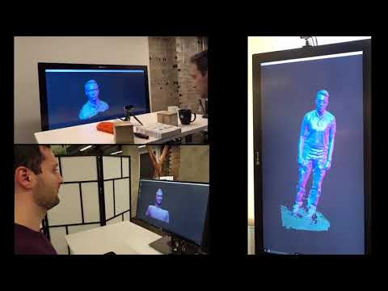
Multi-view RGB-D Capture Setup

Slide 9
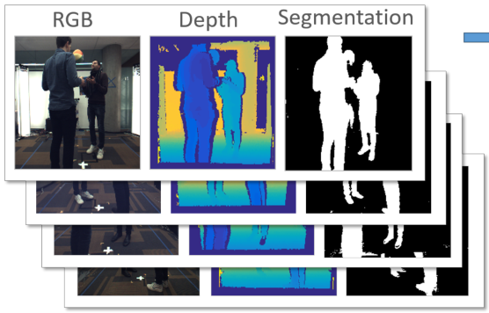
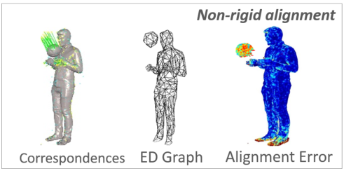
Multi-view RGB-D Capture Setup
Image preprocessing
Depth filtering, background subtraction, visual hull computation
Non-rigid shape reconstruction
Sparse voxel grid
Deformation graph construction
Non-rigid tracking
Projective depth ICP
Global sparse correspondences

Slide 10
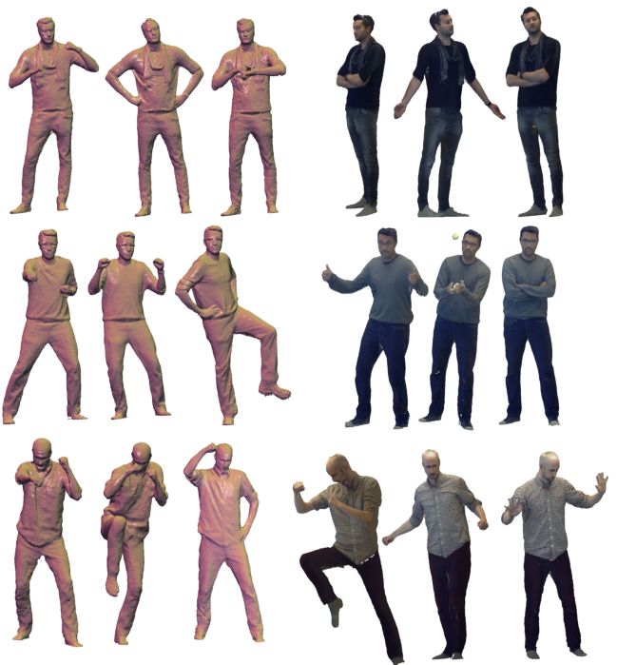
Multi-view RGB-D Capture Setup
Data:
4x Intel Realsense D415
Literature:
Motion2Fusion: Real-time Volumetric Performance Capture [Dou et al.]
Fusion4D: Real-time Performance Capture of Challenging Scenes [Dou et al.]
DynamicFusion: Reconstruction and Tracking of Non-rigid Scenes in Real-Time [Newcombe et al.]

Slide 11
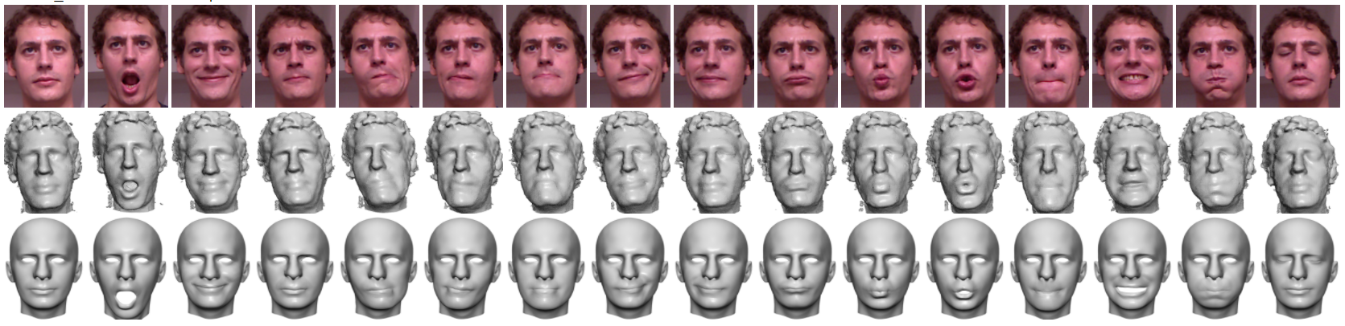
Morphable Model Generation
FaceWarehouse, Cao et al.

Slide 12
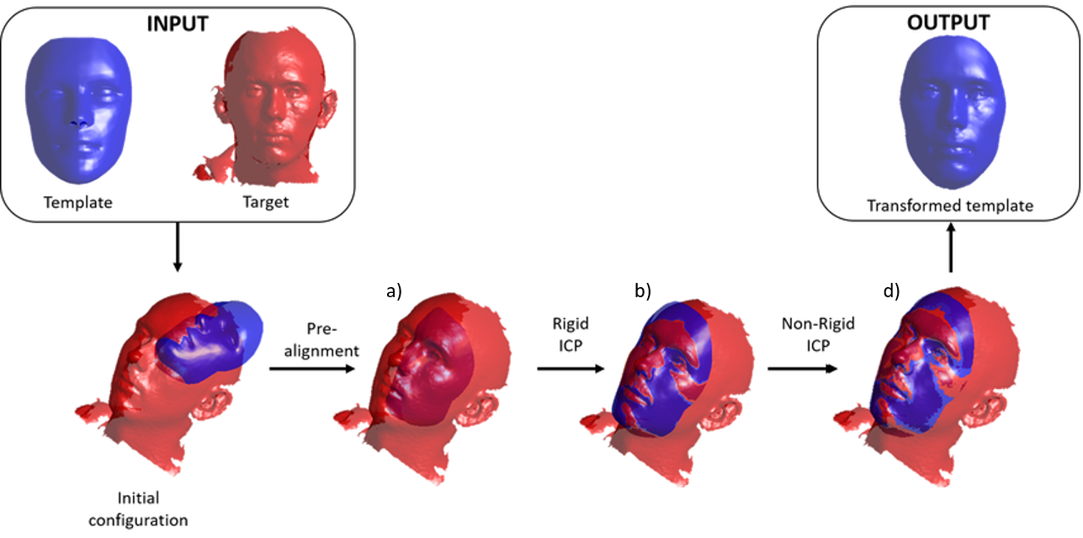
Morphable Model Generation
Template Fitting
Non-rigid ICP
RGB-D input data
As-rigid-as-possible (ARAP)
Image: Zoilo Guillermo Ibáñez de Aldecoa Marín

Slide 13
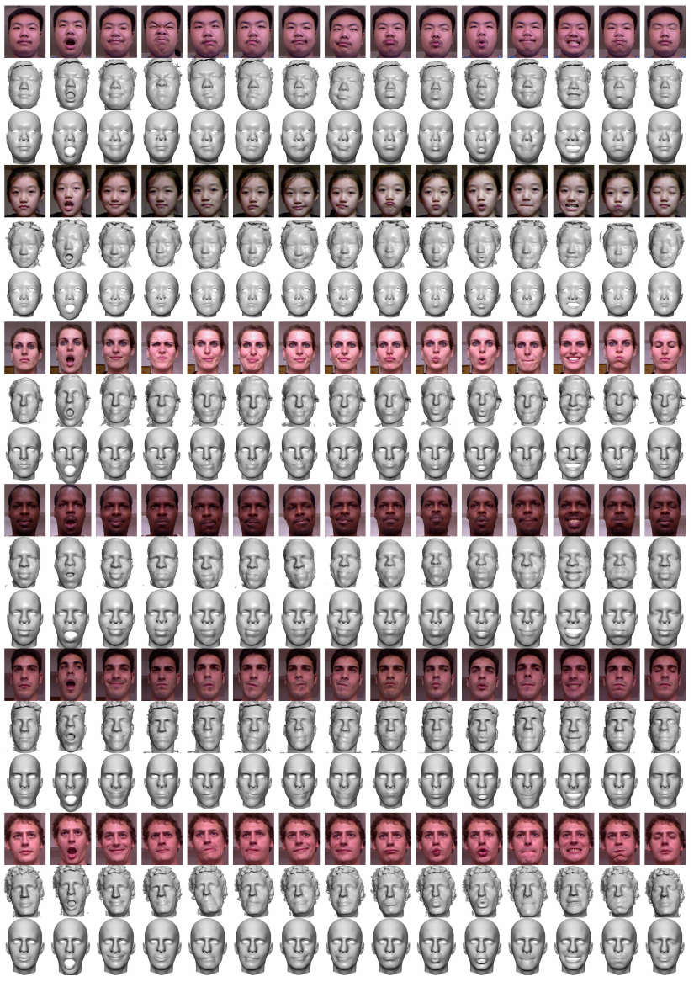
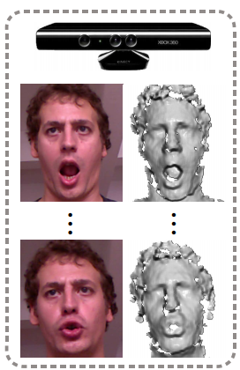
Morphable Model Generation
Template Fitting
Non-rigid ICP
RGB-D input data
As-rigid-as-possible (ARAP)
Process Face Dataset
http://kunzhou.net/zjugaps/facewarehouse/

Slide 14
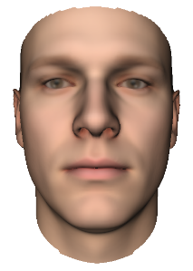
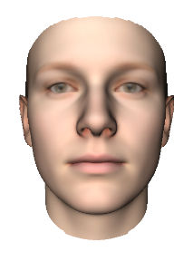
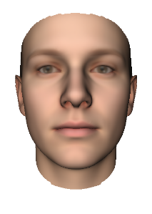
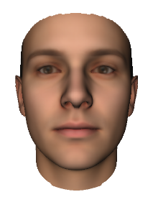
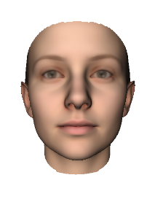
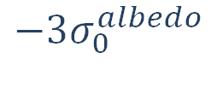


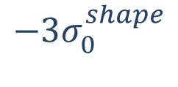
Morphable Model Generation
Template Fitting
Non-rigid ICP
RGB-D input data
As-rigid-as-possible (ARAP)
Process Face Dataset
Build PCA
Power method
$$+{3σ}_{0}^{shape}$$
$$−{3σ}_{0}^{albedo}$$
$$+3σ_{0}^{albedo}$$
$$−{3σ}_{0}^{shape}$$

Slide 15
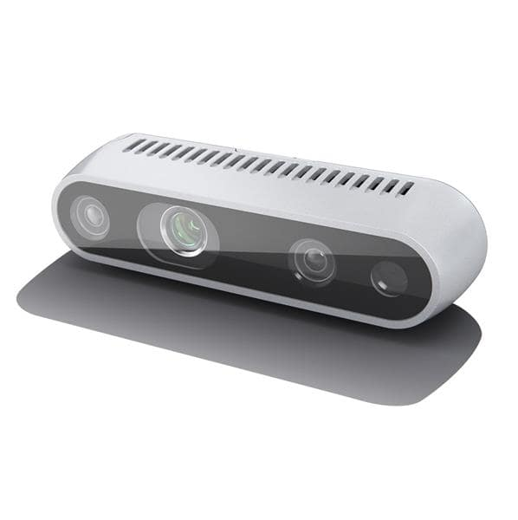
Morphable Model Generation
Template Fitting
Non-rigid ICP
RGB-D input data
As-rigid-as-possible (ARAP)
Process Face Dataset
Build PCA
Power method
[Record new Dataset]

Slide 16
Morphable Model Generation
Data:
FaceWarehouse, Bosphorus Face Database
Captured data (Intel Realsense)
Literature:
Geometric Registration for Deformable Shapes [Li et al.]
Morphable Model [Blanz & Vetter]
FaceWarehouse [Cao et al.]

Slide 17
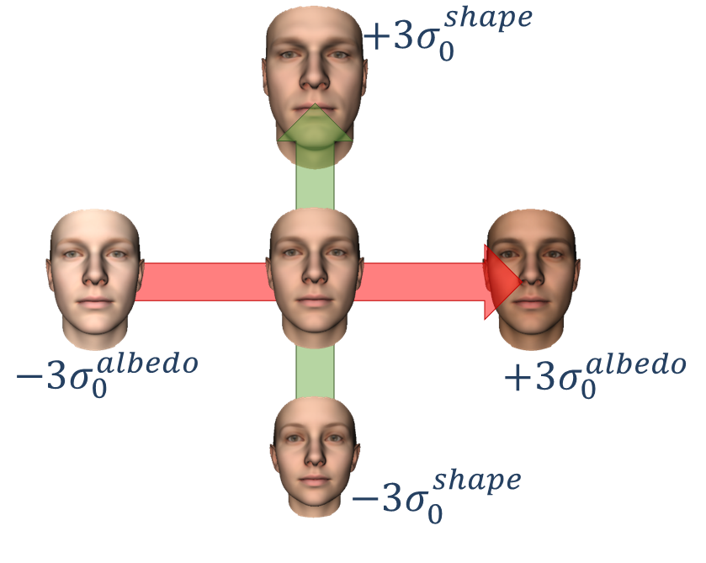
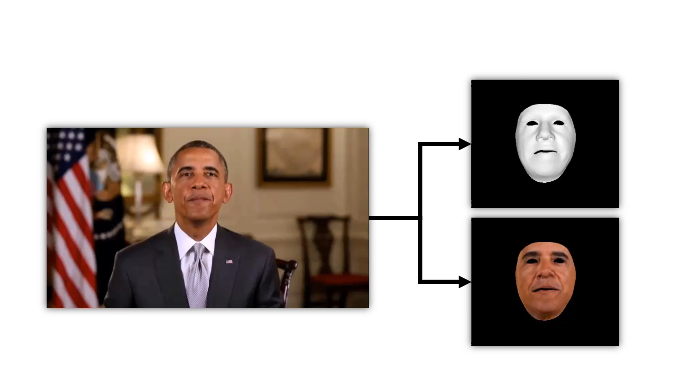
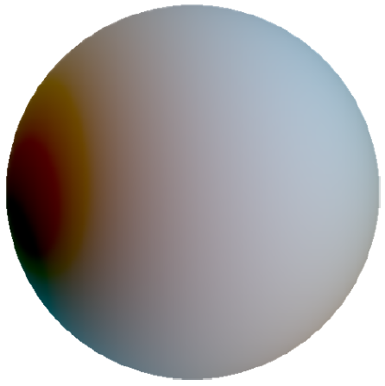


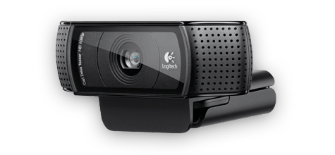
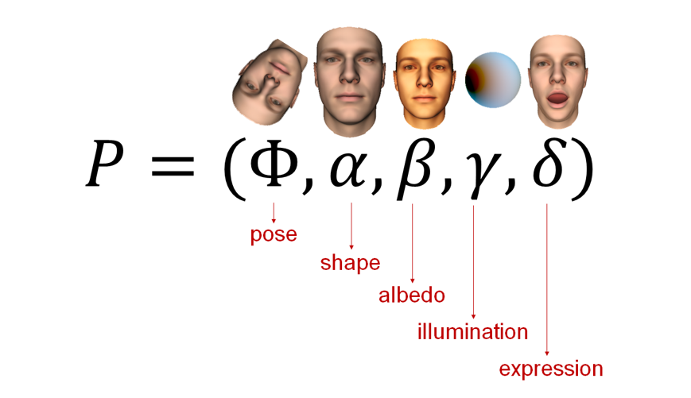
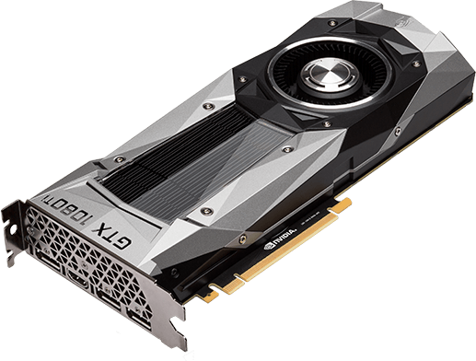
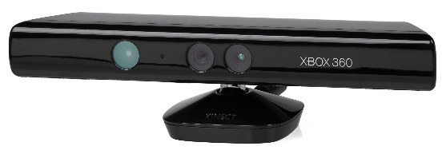
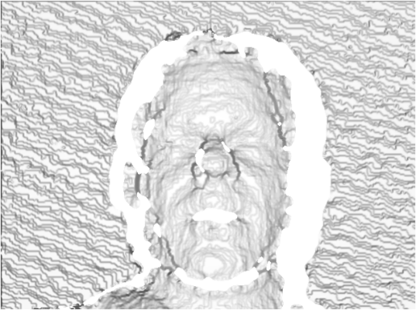
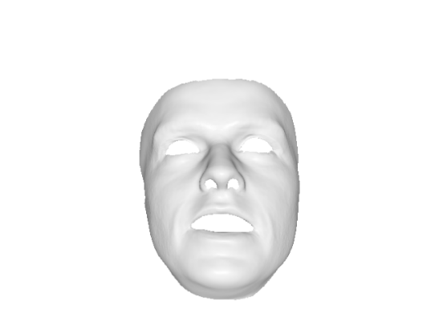
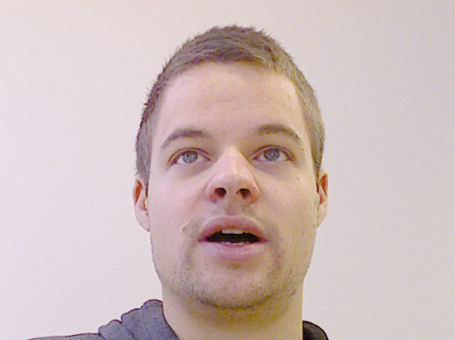
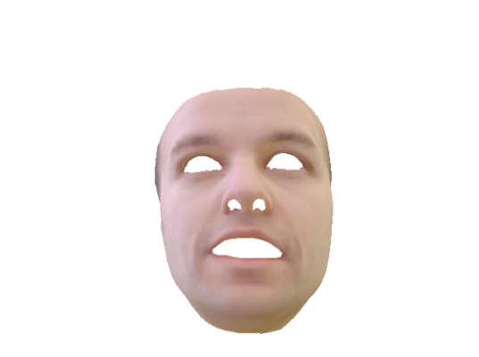

Real-time RGB Face Reconstruction
Parametric Face Model:
Dense Energy Minimization:
$$2$$
Real-time Tracking

Slide 18
Real-time RGB Face Reconstruction
Computer Graphics knowledge (Cuda/OpenGL, DirectX)
Differentiable Renderer

Slide 19

Real-time RGB Face Reconstruction
Computer Graphics knowledge (Cuda/OpenGL, DirectX)
Differentiable Renderer
Morphable Model Fitting
GPU-based GN
Sparse Fitting
Dense Fitting
$$2$$

Slide 20
Real-time RGB Face Reconstruction
Data:
RGB webcam
Literature:
Morphable Model [Blanz & Vetter]
Face2Face,… [Thies et al.]

Slide 21
Thank you for your attention!

